Slide 1

Introduction to Mobile Wireless Mesh Networks
By Beka Daniel Bonsa
IDATT2104
NTNU
Notes:
Welcome to my presentation about the article Ive written covering the introductory key concepts, applications, and future potential of Mobile Wireless Mesh Networks.

Slide 2
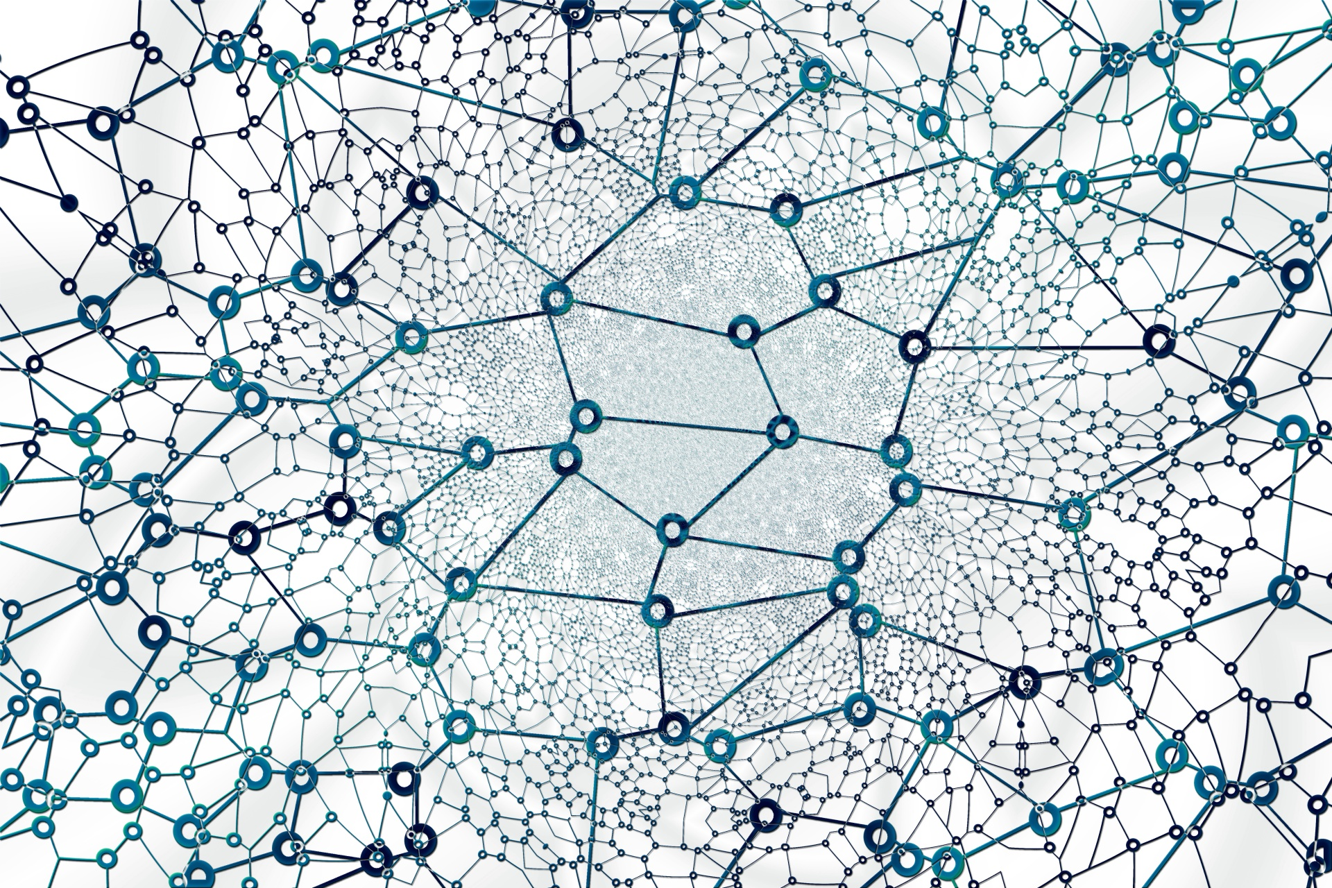
Table of contents
Introduction to MWMNs
Pros and cons
Routing protocols
Current and future developments
2
Notes:
In the article prepared, ive tried to touch upon the intricacies of MWMNs, exploring their unique attributes, benefits, and the challenges they present.
It also looks at the real-world applications where this technology is playing a pivotal role, such as in remote connectivity and in the smart city infrastructure. These examples will underscore the practicality and potential of MWMNs.
Additionally, it will extend to the current and potential future developments in MWMNs, touching on some exciting advancements. By the end of this presentation, we hope to provide a comprehensive understanding of Mobile Wireless Mesh Networks and their significant role in our increasingly interconnected world.

Slide 3
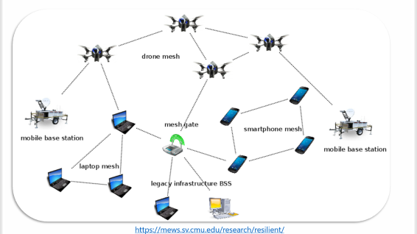
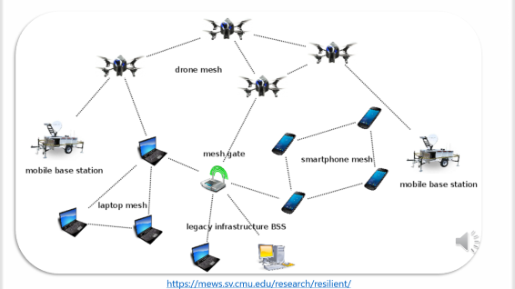
MWMN
What are MWMNs (mobile wireless mesh networks)?
Notes:
First question one might ask, is what mobile wirless mesh networks are.

Slide 4

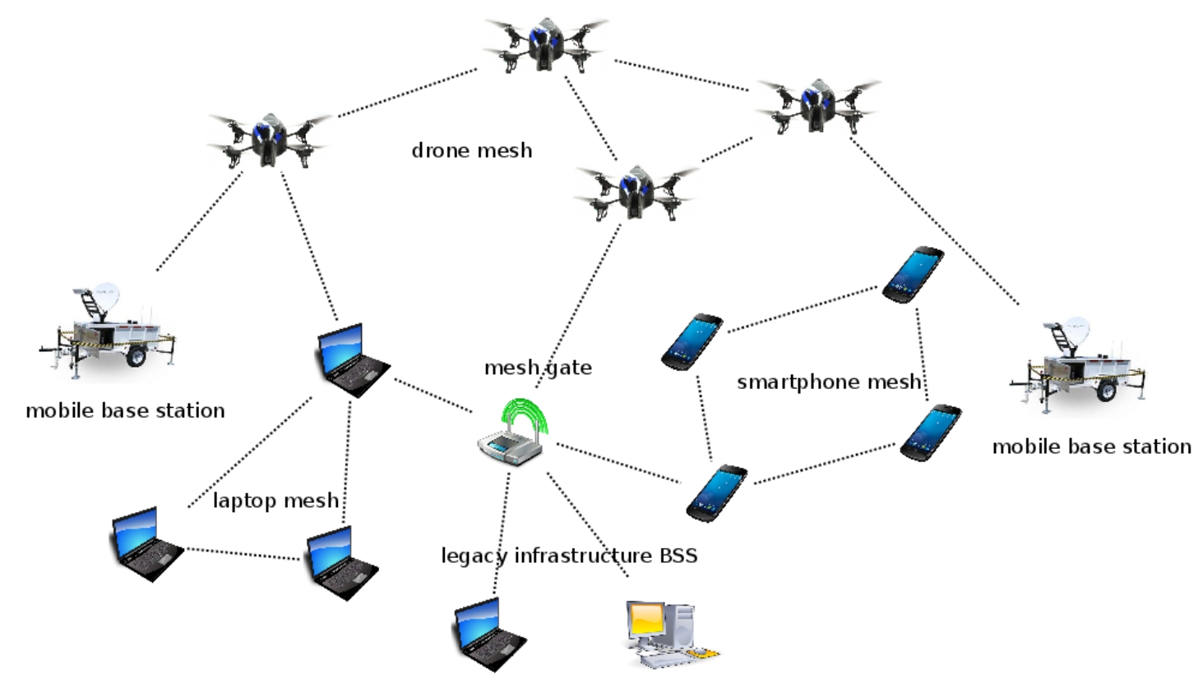
https://mews.sv.cmu.edu/research/resilient/
Notes:
A Mobile Wireless Mesh Network (MWMN) is a form of networking where wireless nodes are interconnected to form a "mesh topology". In a mesh network, devices (also known as nodes) are connected directly and dynamically to as many other nodes as possible. These nodes cooperate with one another to efficiently route data from and to clients. This way traffic can be routed via multiple paths in the network.
Mobility: Mobile wireless mesh networks are essentially mesh networks where the nodes are mobile. That means the nodes (which could be devices like laptops, phones, or routers) can move around, and the network will dynamically reconfigure itself to best maintain connectivity.
Self-Forming and Self-Healing: One of the key advantages of MWMNs is that they are self-forming and self-healing. This means that they can automatically establish network connectivity, and if a node fails or drops out, they can reconfigure themselves to ensure data can still be passed along the network.
Applications: MWMNs are ideal for situations where network coverage is needed quickly, or in areas where it's difficult to provide coverage with a traditional network. This could be in disaster response scenarios, military operations, outdoor festivals, or to extend the coverage of a wireless broadband network in urban or remote areas.

Slide 5
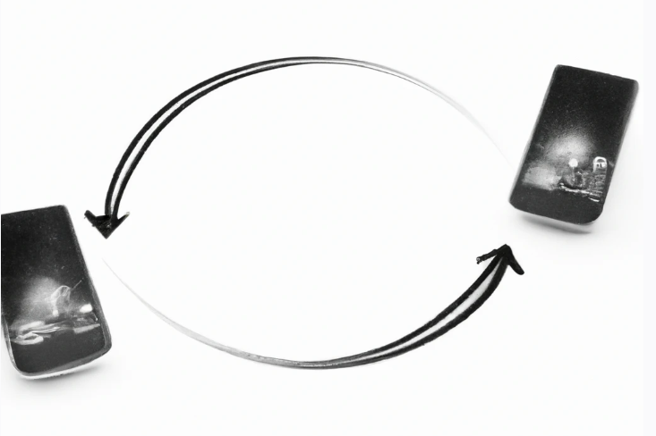
Advantages of using MWMNs
Self-organizing
Mobility
Resilience
Cost-effective
Scalability
5
Notes:
Mobile Wireless Mesh Networks (MWMNs) offer numerous advantages, making them a popular choice for many wireless communication applications
Self-Organizing: MWMNs are inherently self-configuring, meaning the network automatically determines the best route for data packets. This leads to efficient use of resources and reduced setup and maintenance time.
Support for Mobility: MWMNs can accommodate moving nodes. This makes them ideal for scenarios like vehicular networks, drones, or mobile devices in general.
Resilience: Due to their decentralized nature, MWMNs have a high level of resilience. If a node fails, the network can automatically re-route data via different paths, ensuring consistent connectivity.
Extended Coverage: Mesh networks can extend coverage beyond the range of a single access point. This is beneficial in large areas or places with physical barriers.
Cost-Effective: Since MWMNs use each device as a transmission point, less infrastructure is needed compared to traditional wireless networks. This makes them cost-effective, particularly in areas where installing physical infrastructure is challenging or costly.
Scalability: MWMNs can easily grow to accommodate more devices. As new nodes join the network, they seamlessly integrate and contribute to the overall mesh.

Slide 6
Disadvantages of using MWMNs
1.
2.
3.
4.
5.
Complexity
Interference
Latency
Lower data rates
Limited range of individual nodes
6
Notes:
Mobile Wireless Mesh Networks (MWMNs) do have some challenges or disadvantages that should be considered:
Complexity: The self-configuring and self-healing nature of MWMNs can lead to complex network structures, which can be difficult to manage and troubleshoot.
Interference: By allocating separate frequency bands for different parts of the network, the likelihood of interference can be reduced.
Nevertheless, this doesn't entirely eliminate the potential for interference. Other electronic devices, weather conditions, physical obstacles, and even the network's own signals can create interference. Therefore, while frequency management strategies can help to mitigate interference, it still stands as a potential disadvantage in MWMNs.
Latency: The multi-hop nature of mesh networks can cause an increase in latency as data packets traverse several nodes to reach their destination.
Lower Data Rates: While aggregate bandwidth increases with the number of nodes, individual data rates might decrease in very dense networks due to shared channel and interference.
Limited Range of Individual Nodes: Each individual node in a MWMN often has a limited range, which can impact the network's overall performance, particularly in areas with few nodes or large distances between nodes.

Slide 7
Routing protocol types
Proactive (table-driven)
Reactive (on-demand)
Hybrid
7
Notes:
There are three main types of routing protocols used in MWMNs: proactive, reactive, and hybrid.
Proactive (Table-Driven) Protocols: Proactive routing protocols continuously learn and maintain up-to-date routing information from each node to every other node in the network. This information is usually kept in routing tables. When a route is needed, it is already known and can be used immediately. This leads to lower latency. However, this comes at the cost of increased overhead, as updates must be constantly propagated throughout the network. An example of this is the Destination-Sequenced Distance Vector (DSDV) protocol and the Better Approach To Mobile Adhoc Networking (B.A.T.M.A.N.).
Reactive (On-Demand) Protocols: Reactive routing protocols create routes only when they are needed. If a node wants to send a packet to another node, the routing protocol will find a route for it. This can lead to higher latency because route discovery must occur before a packet can be sent. However, these protocols tend to have lower overhead since routes are only calculated when needed. Examples include the Ad hoc On-Demand Distance Vector (AODV) and Dynamic Source Routing (DSR) protocols.
Hybrid Protocols: Hybrid routing protocols aim to combine the strengths of both proactive and reactive routing protocols. These protocols can be configured to use proactive routes within a local neighborhood (or zone), while using reactive routing for destinations outside of the neighborhood. This allows them to scale better for larger networks. The Zone Routing Protocol (ZRP) is a good example of a hybrid routing protocol.

Slide 8
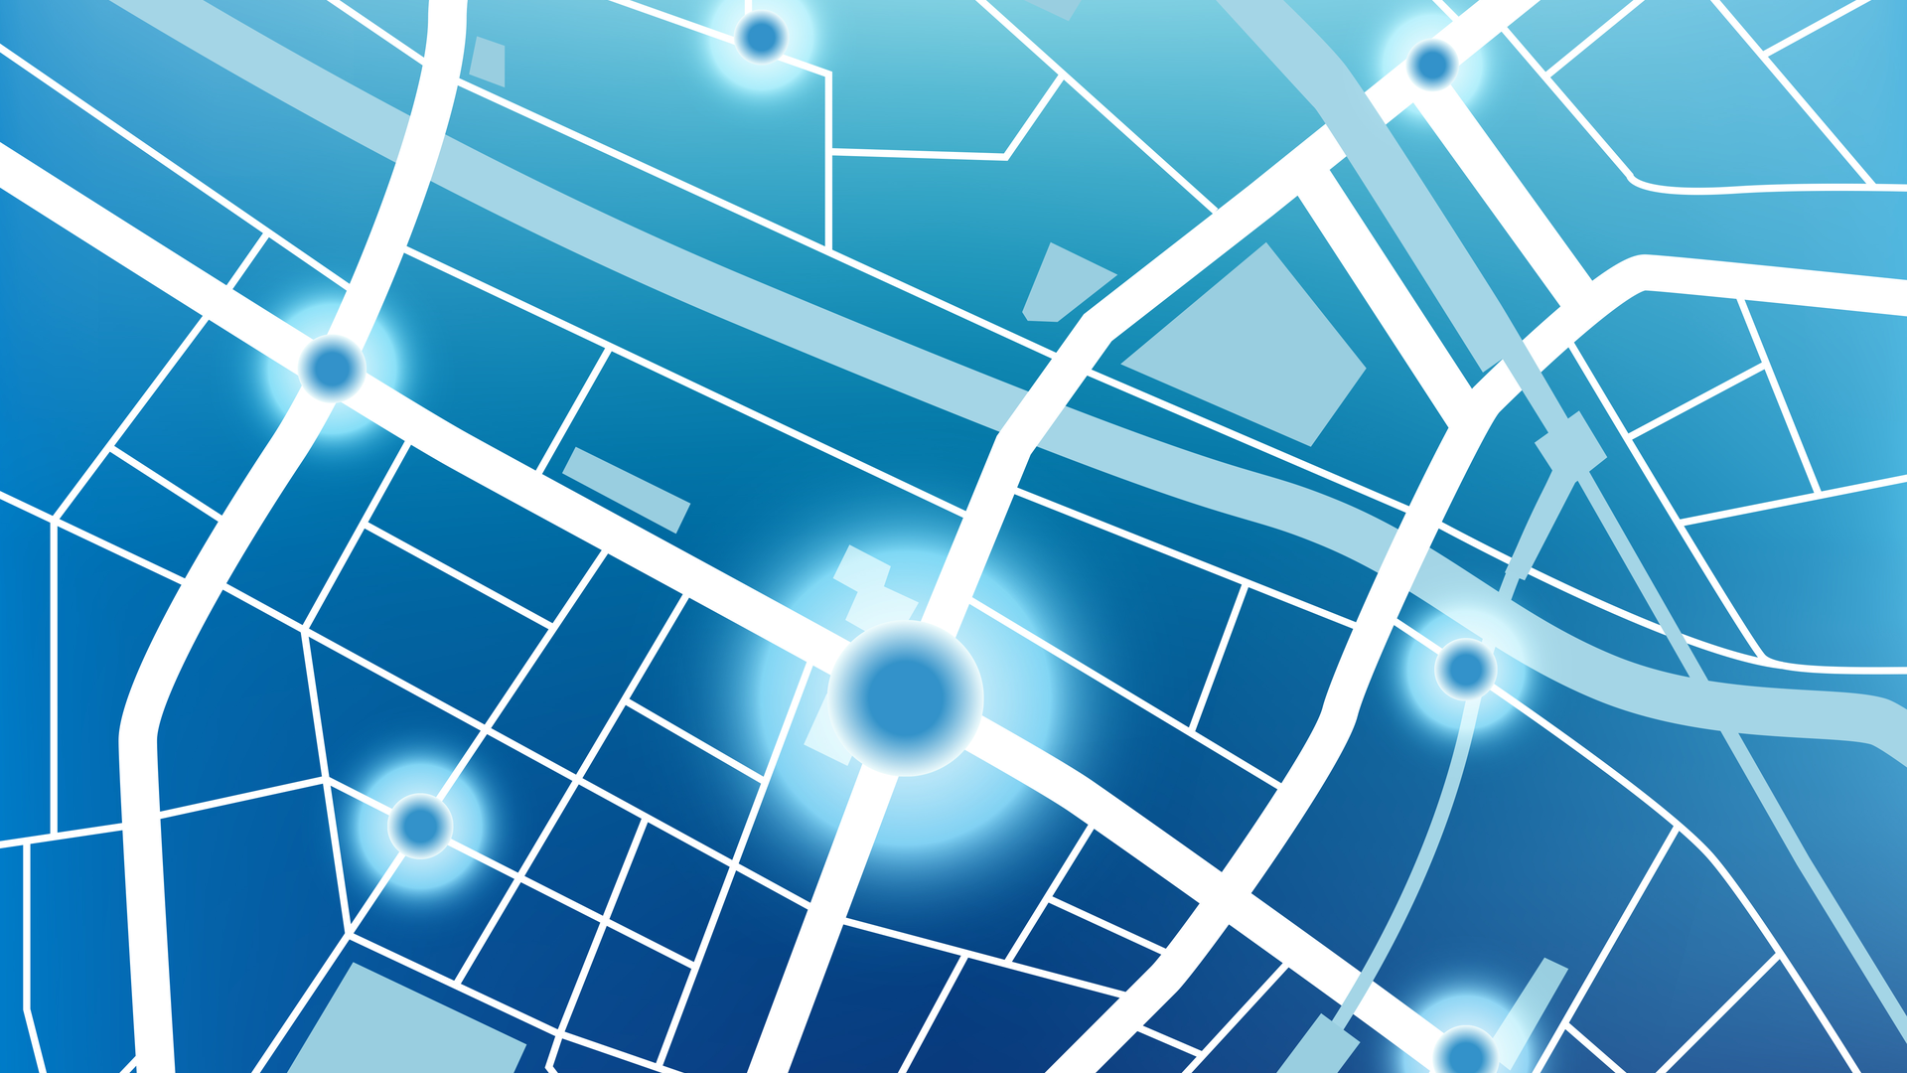

Routing protocols
Which routing protocols and why
DSDV
B.A.T.M.A.N
8
Notes:
For the routing protocols chapter, DSDV and BATMAN were used as examples for some of the problems routing protocols must deal with.

Slide 9
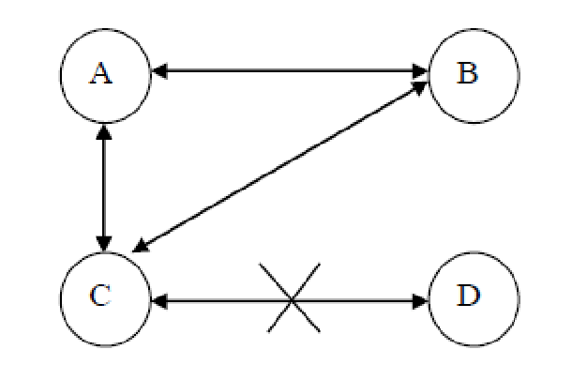
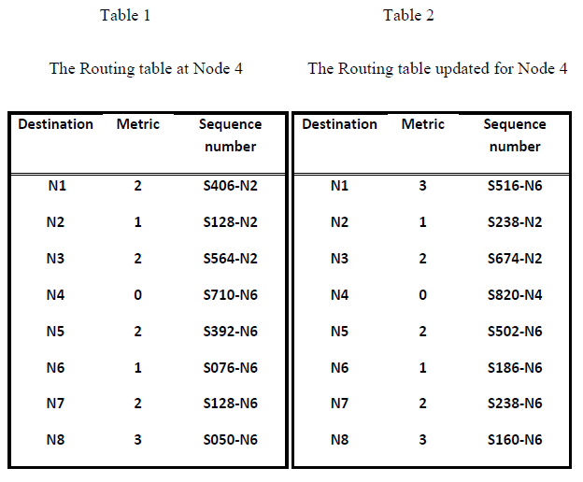
Proactive (table-driven) routing protocols
https://www.researchgate.net/publication/46391968/figure/fig5/AS:668606006317068@1536419502601/Counting-to-infinity-problem-Consider-nodes-A-B-C-and-D-making-up-a-MANET-as.png
https://mti.binus.ac.id/files/2014/08/Untitled2.png
9
Notes:
One problem that routing protocols like DSDV could encounter is the routing loop problem, which occurs when packets endlessly cycle between nodes. This problem is illustrated with a three-node network (A, B, C, D), where if path CD disconnects, a routing loop could form between A and C or B and C as they attempt to reach D.
DSDV manages this issue by tracking sequence numbers for each destination node. An update with a higher sequence number for a destination prompts the node to modify its routing table, keeping routes current. However, despite its effectiveness, DSDV has limitations in a mesh topology. Frequent routing table updates can consume significant network resources, especially on a large scale. As such, other table-driven protocols such as OLSR and BATMAN, which are more efficient are preferred.

Slide 10

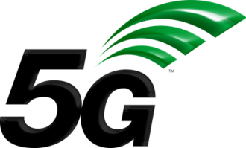
Current and potential developments
https://www.engineersgarage.com/wp-content/uploads/2021/11/TCH36-01-scaled.jpg
https://upload.wikimedia.org/wikipedia/en/thumb/4/43/3GPP_5G_logo.png/330px-3GPP_5G_logo.png
10
Notes:
As 5G technology becomes more widespread, Mobile Wireless Mesh Networks (MWMNs) are set to reap significant advantages, including lower latency, greater speed, and increased capacity. As each new generation of wireless communication technology emerges, MWMNs continually enhance their capabilities. This progression could result in a far future where wired connections may eventually be phased out.
With ongoing advancements in AI and machine learning, these technologies can be leveraged to optimize and manage networks more effectively. This could potentially involve improving routing decisions through AI-powered predictions, thereby avoiding unstable connections.

Slide 11


Conclusion
https://miro.medium.com/v2/resize:fit:1400/1*IPB1WB5fFubOwSiMO3jfrg.jpeg
https://assets.nautil.us/sites/3/nautilus/tTl7mTIP-Gallagher_HERO.png?auto=compress&fm=png&ixlib=php-3.3.1
Notes:
This technology has Applications from improving connectivity in smart cities to potentially establishing communication networks on other planets, which indicate the potential to transform the digital communication landscape.
All in all, it’s a technology with great promise and future ahead, but its still important to know its strengths and weaknesses to avoid unnecessary problems later on.

